Slide 1
Sermon Interpretation for PRTS
Research & Developed by Muttaki I. Bismoy
Mentor – Professor Rahat Rafiq
Funded by PRTS
Presented to Zachary Ash

Slide 2
What’s Behind the Scene
Website
Frontend framework : VueJs [JavaScript based web Framework]
Backend : Flask [Python based micro web framework]
Algorithm
Video Emotion Detection : DeepFace
Audio Emotion Detection : Wav2Vec2Processor
Recognition Pipeline : DistilRoBERTa

Slide 3
Why DeepFace ?
01
Integrates directly with Python
Easy to implement and more accuracy
Requires less computational power
Optimal balance between ease of use and computational efficiency
Notes:
DeepFace would be the best choice for initially detecting emotions in video data from sermons.
DeepFace is relatively easy to execute, as it integrates directly with Python and offers built-in functionalities for emotion recognition with minimal setup.
It requires less computational power compared to more complex models like I3D or Video Swin Transformer, making it suitable for a quick and efficient deployment.
Its pre-trained models are user-friendly, offering an optimal balance between ease of use and computational efficiency.

Slide 4
Transformers Model Wav2Vec2Processor
01
02
03
Other Less Accurate Transformer Models
Self-supervised transformer model pre-trained on large unlabeled datasets and subsequently fine-tuned for a particular task
Trained on large amounts of unlabeled audio data
Tested on LibriSpeech &
Fine tuned using Connectionist Temporal Classification (CTC)
HuBert, VGGish, OpenSmile

Slide 5
Why Wav2Vec2Processor ?
Wav2Vec2Processor is a state-of-the-art model by Facebook AI for Automatic Speech Recognition (ASR).
Performance: Highly accurate ASR for English, well-suited for converting speech to text
Ease of Integration: Pre-trained and compatible with transformers library, making it accessible and easy to implement in Flask
Efficiency: Provides precise transcriptions, a vital step for emotion detection in audio

Slide 6
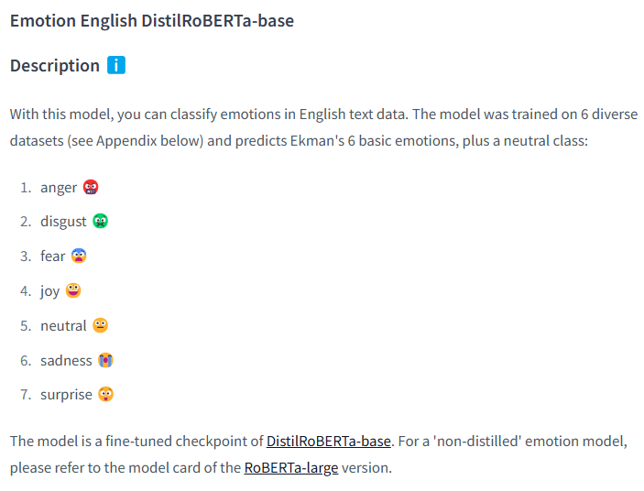
Emotion Recognition Pipeline: DistilRoBERTa A distilled, lighter version of RoBERTa, optimized for efficient, real-time applications
01
03
Efficiency
Low Latency
Speed
02
04
Pre-trained on Emotion Dataset
Notes:
DistilRoBERTa Overview: A distilled, lighter version of RoBERTa, optimized for efficient, real-time applications.
Advantages for Emotion Detection:Speed and Efficiency: Faster processing while maintaining high accuracy for emotion classification.
Pre-trained on Emotion Dataset: Fine-tuned specifically for emotion classification, making it effective for understanding text-based emotions.
Low Latency: Ideal for real-time applications, offering an excellent balance of performance and speed.

Slide 7
Why DistilRoBERTa ? Balanced speed Accuracy Specific fine-tuning for Emotion detection
Alternative Pre-trained Detection Pipelines
BERT and RoBERTa: General-purpose transformers that can be adapted for emotion recognition with suitable fine-tuning
GPT Models: While powerful for text generation, they can be adapted for sentiment analysis but lack emotion-specific training
ALBERT and XLNet: Efficient alternatives, though less commonly used for emotion-specific applications due to limited training on emotion datasets

Slide 8
Notable Libraries
DeepFace: A computer vision library for analyzing emotions in video frames. Supports various models for detecting emotions, age, gender, and facial attributes.
Transformers (Hugging Face): Provides pre-trained models and processors like Wav2Vec2 and DistilRoBERTa. Simplifies the integration of ASR and emotion detection models into applications, making it a versatile choice for NLP and ASR tasks.
MoviePy: Simplifies multimedia file handling. Used for extracting audio from videos, cutting, combining, and applying effects on video files, making it essential for audio-video analysis.
TorchAudio: A library that works with PyTorch for efficient audio data processing. Essential for tasks like resampling, normalization, and feature extraction, ensuring the audio data is properly formatted for models like Wav2Vec2.
Soundfile: A library for reading and writing sound files, including formats like WAV and FLAC. Provides easy access to audio data and works efficiently with numerical arrays, aiding in the processing and storage of audio chunks.
CV2 (OpenCV): A powerful library for handling image and video frames. Used to capture and manipulate frames from videos, enabling efficient emotion analysis on a frame-by-frame basis.
UUID: Generates unique identifiers for filenames (frames, graphs, audio), ensuring that files are stored without overwriting or conflicts.

Slide 9
Current Limitations
UI/UX
Sound Vector
Some small tweaks like naming the frames and timespans
Small bugs while decoding the sound vector

Slide 10
Future Goals
Integrating Speech Emotion and Integrate it altogether
Implement MLM or LLM models for better accuracy and reusability
If we do not get proper outcome, we might move towards fine-tuning by ourselves

Slide 11

Thank You Demo Time…

